Slide 1
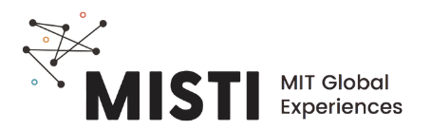
Introduction to Polymers

Slide 2

Which things are made from polymers?
clothing
shoes
the ball
Notes:
Polymers are all around us every day. Many of you likely know a few examples of different polymers, or plastics in a soccer game. Can anyone volunteer examples?

Slide 3
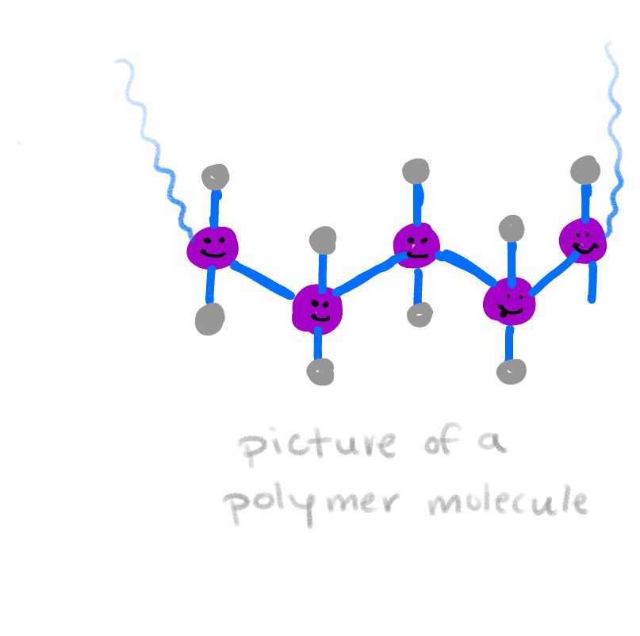
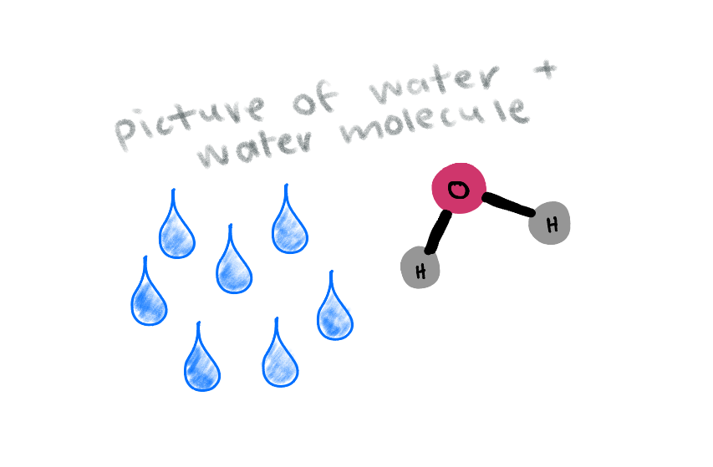
POLY - MER
many
parts
water:
a small molecule
(3 atoms)
polymer:
a large molecule
(> 1,000 atoms)
Notes:
**Does the word break down like this in Portuguese? If not, adjust slide accordingly.** Polymer translates literally into “many parts.” We can think of small molecules you learn about in chemistry, such as water, as small molecules, which are made up of anywhere from 2 to >100 atoms if they are quite complex. Polymers are made of many small molecule units, called monomers, bonded together to create a looong molecule which contains 100 to over one million monomers.

Slide 4
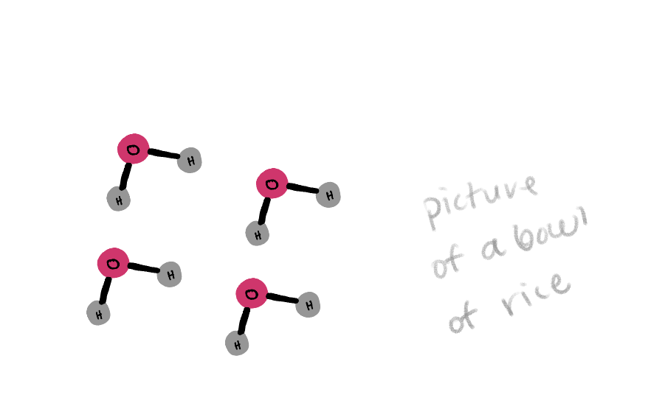
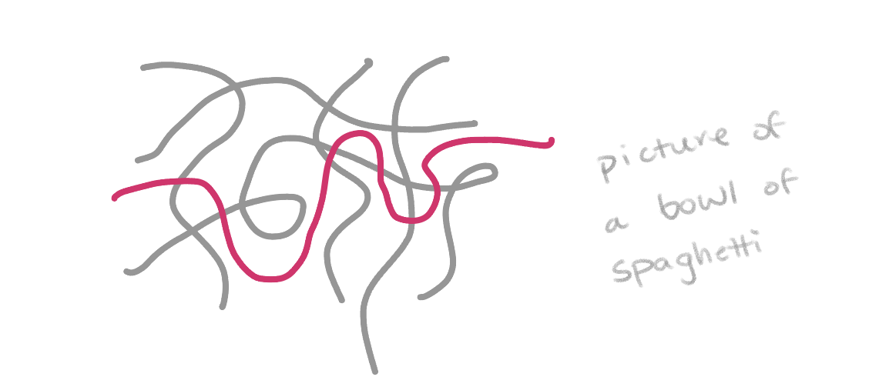
Polymers are like spaghetti
Notes:
Polymers have many unique properties as you just saw in the examples we were looking at. The main difference between polymers and other materials such as ceramics or metals is the length of the molecules. We can think of small molecules as rice- easy to mix, difficult to eat with, say, chopsticks since each grain is free to move around without the others. Polymers, on the other hand, are like spaghetti. If we connected a bunch of rice grains end to end, we’d eventually reach the length of a spaghetti noodle, much as monomers link together to form a polymer. Eating noodles with chopsticks is easy because they are entangled- it’s easy to grab a bunch at once, and extracting just one is actually quite challenging. This entanglement, and the corresponding friction between the long strands, is what give polymers many of their unique properties.

Slide 5
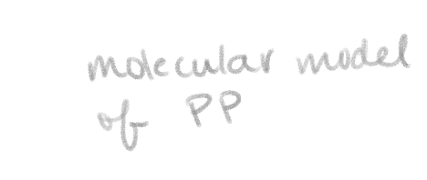

How to name or draw a polymer
Many representations for one molecule
Molecular formula
Structural formula
Line structure
Name
Model
Polypropylene
(C₃H₆)_{n}
Polystyrene
(poly(1-phenylethene-1,2-diy))
(C₈H₈)_{n}
Notes:
There are many different ways to represent the same polymer, and it is useful to be able to translate between them. Common polymer often have a common name or trade name, as well as a technical name based on rules given by the international union of pure and applied chemistry. There a molecular formula, typically the repeating unit with a subscript n, which stands for the number of repeats. This can also be written as a structural or line formula, and modelled in space with various approximations; here a ball and stick model is shown. We’ll hand out a table with many of the polymers we’ll be discussing this week for reference.

Slide 6
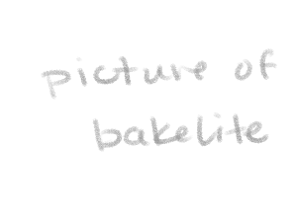
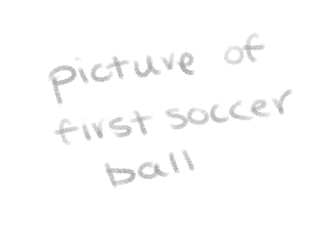
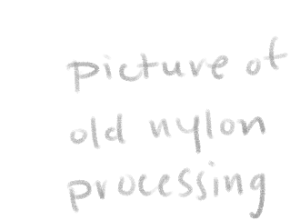
A brief history of polymers
1500’s:
Mayans create balls from rubber trees.
1839:
Goodyear accidentally discovers vulcanization.
1907:
First synthetic polymer is made- Bakelite
1976:
Polymers overtake steel as most widely used material by volume
1855:
Goodyear creates first rubber soccer ball.
1938:
Nylon is invented
1941:
Polyethylene is invented- now the most common polymer.
Natural polymers (wood, silk, proteins) used long before
http://matse1.matse.illinois.edu/polymers/time.html
Notes:
Natural polymers have existed for as long as humans, and have been used as building materials, food, and clothing- in the 1500’s the Mayan records show playing with balls created form rubber trees. 300 years later, Charles Goodyear accidentally discovered that heating that rubber with sulfur additives cures it into a tough, long-lasting rubber, which he used to make the first rubber soccer ball a few years later. Previously balls were made of animal bladders or leather, which easily became water logged and leaked air. The first completely man-made polymer is created in 1907 and called Bakelite, which was used for everything from telephone casings to jewelry. Nylon is invented in 1938, with great impact to the fashion industry, closely followed by polyethylene, which would go on to become the most produced polymer in the world. By 1976, polymers are the most poduced material in the world.

Slide 7
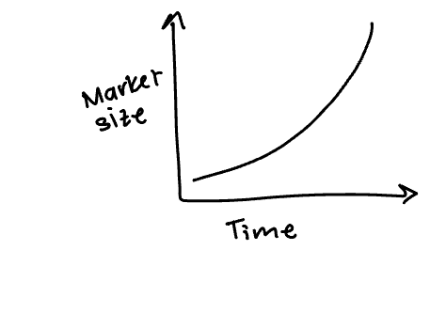
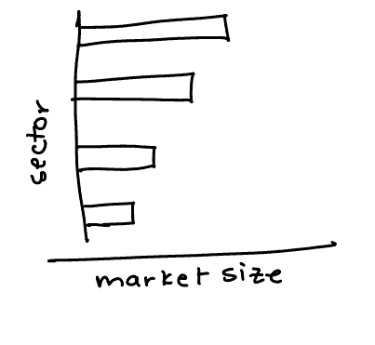
Polymer usage today
Global plastics production
Production by market sector
Market Size:
$593
BILLION
(2021)
https://www.grandviewresearch.com/industry-analysis/global-plastics-market
Notes:
The global production of all types of plastitcs has grown exponentially since the 1950’s and 60’s, to a huge $593 billion today. Plastics are found across many different industries, with packaging being the largest by far, following by construction and textiles.

Slide 8
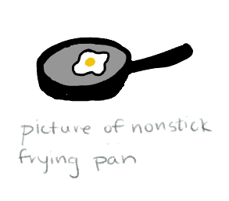
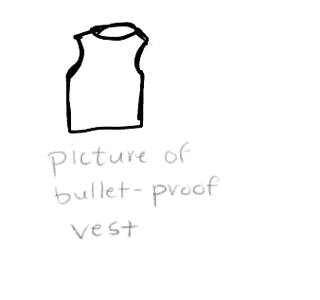
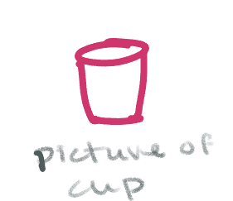
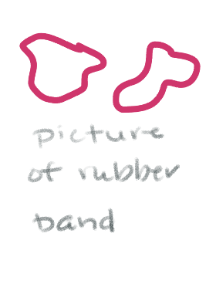
Polymer properties vary widely
Polystyrene
stiff & brittle
Rubber
tough & stretchy
Teflon
slippery
Kevlar
very strong
Notes:
There are so many different properties achieved through different chemistries and processing. The range from stiff and brittle polystyrene to tough and stretchy rubbery materials like polybutadiene. There are also highly specialized materials, such as teflon or Kevlar which have highly engineered properties. In this case, the fluorine atoms in teflon repel most other atoms, making non-stick pans slippery, while alignment and bonding between the chains in Kevlar create an incredibly strong and light material.

